Slide 1



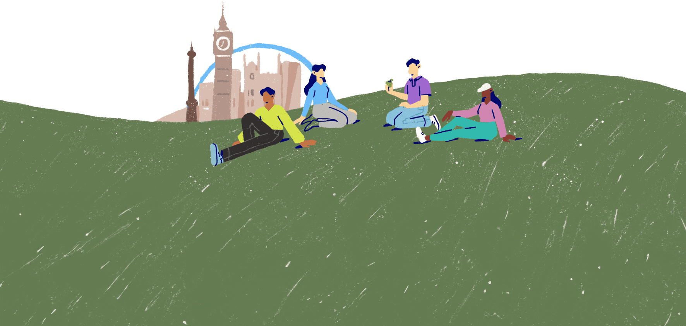
Mental wellbeing: risks and triggers
Lesson 4

Slide 2

Life events and experiences
Photo from Canva
Life isn't always easy!
Certain things people experience in life can affect their mental wellbeing.
Some experiences can also cause mental health challenges.
One example of this could be the pandemic. For some people, the things they experienced during COVID-19 caused mental health difficulties, such as social anxiety.
Picture of someone wearing a face mask

Slide 3



Risk factors for mental health
There is no single cause that leads to mental health challenges, but there are some risk factors that health professionals have identified.
Risk factors include:
Genetics
Homelessness and unemployment
Alcohol and other drug use
Discrimination, injustice and bullying
Family conflict
Stressful life events
How might a person who falls into one or more of these categories look to protect their mental health and wellbeing?

Slide 4


Challenging circumstances and tough times
We all experience difficulties in life.
Of course, what one person finds challenging, another person may not.
We are all different.
The same individual could even find that they cope differently with a challenge at different times in their life.
Can you think of some circumstances or events that could prove very difficult for many people, that would affect most people's mental wellbeing?

Slide 5



Protective factors for mental health
We can't avoid challenging situations, and a lot of things that happen in life are beyond our control.
To support good mental health and wellbeing, we can build protective factors. These will help us cope better when we face tough times.
Protective factors include:
Physical health
Physical activity
Social support and a sense of belonging
Self-belief and pride in our identity
Attributes and skills such as adaptability, problem-solving and resilience
Consider how you feel about your own protective factors. Are there any areas that you feel you could build on?

Slide 6


Modern life and mental wellbeing
Modern life is fast-paced and pressured.
Modern life also relies heavily on the use of technology. The digital age has presented a set of potential risks to our wellbeing that previous generations weren't exposed to.
​What aspects of modern life do you feel pose the greatest risks to your mental health and wellbeing?

Slide 7
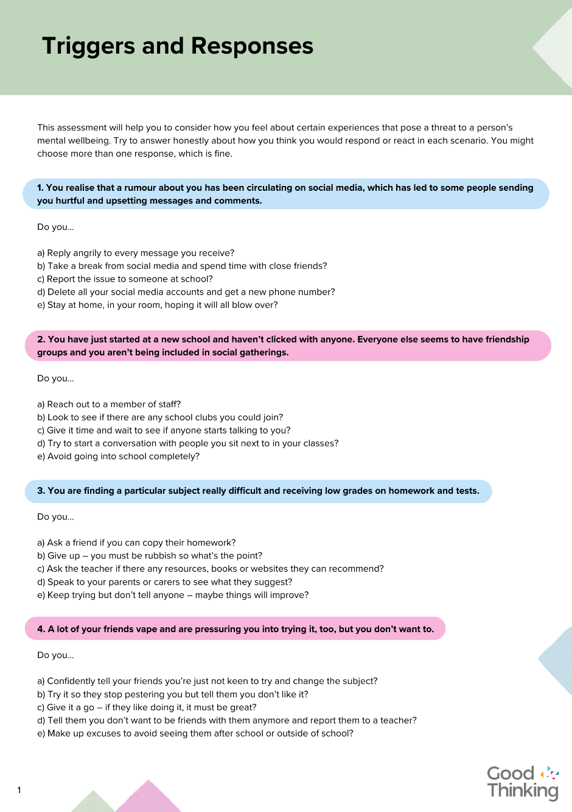
Triggers and responses
How you react and respond to certain situations is personal to you and may be different depending on your mental wellbeing at the time of a potentially challenging event.
Take a look at the Triggers and Responses quiz and score yourself today. Remember, your responses reflect your current state of wellbeing, which can frequently change.

Slide 8
Making healthy choices
Some friends are chatting in a WhatsApp group about a party they are having. One person in the group isn't allowed to attend. They feel left out, and they find it upsetting to see all the excited messages.
What could they do?
In many situations, we can make decisions that will support our mental health and wellbeing.
Let's take a look at some example scenarios and consider what choices we have...
A young person has just found out that they have to move house and school, because their parent has a new job and needs to relocate. This is very unsettling; they feel anxious and angry.
What could they do?
A student has recently failed one of their exams. They feel cross with themselves and think their parents will be disappointed, too. They are questioning their ability in all their studies and have lost confidence in themselves.
What could they do?

Slide 9

"Mental health problems don't define who you are. They are something you experience. You walk in the rain, and you feel the rain, but, importantly, YOU ARE NOT THE RAIN.”
Matt Haig
Photo by Jan Willem on Unsplash

Slide 10


